Slide 1


To add:
if customer asks for their referral code
KOKO Core Training
Notes:
old documentation: https://docs.google.com/document/d/1sLxvy7J_l4j0b7-YziZj-y6gxB2fdTza9TlN-5vbDyk/edit

Slide 2

Contents/ Purpose of the document
To provide you as a KOKO Core user with the knowledge, skills, and tools you need to successfully navigate, utilize and support our stove customers and KOKOpoint Agents:
This presentation will cover:
KOKO Core overview
Account creation
Log in
Dashboard
KOKOpoints
Customers- overview, details, actions
Orders-views and cancellation
Pre-orders- views and cancellation

Slide 3
What is KOKO Core
The KOKO Networks Core Engine is the heart of KOKO Networks software application suite that runs in the cloud. Its main responsibilities are to:
Control all KOKO Networks infrastructure (KOKO points, Smart Tanker and Smart Depots) and operations (refills, online status, ethanol stock levels etc).
Maintain the central data repository for a country network- Customers, fuel purchase, cooker purchases etc
Ensure all package applications work together seamlessly and securely.
Supply KOKO’s analytics platform with raw data, which is used to create outputs that can be used to take decisions on operations and strategy
Seamlessly integrates with other systems within KOKO Networks:
Odoo ERP which manages Finance and Accounting, Distribution and Logistics, Inventory Management, CRM Agent Pipeline Management.
Business Intelligence and Analytics tools- Tableau, Grafana
Safaricom MPESA payment platform.

Slide 4
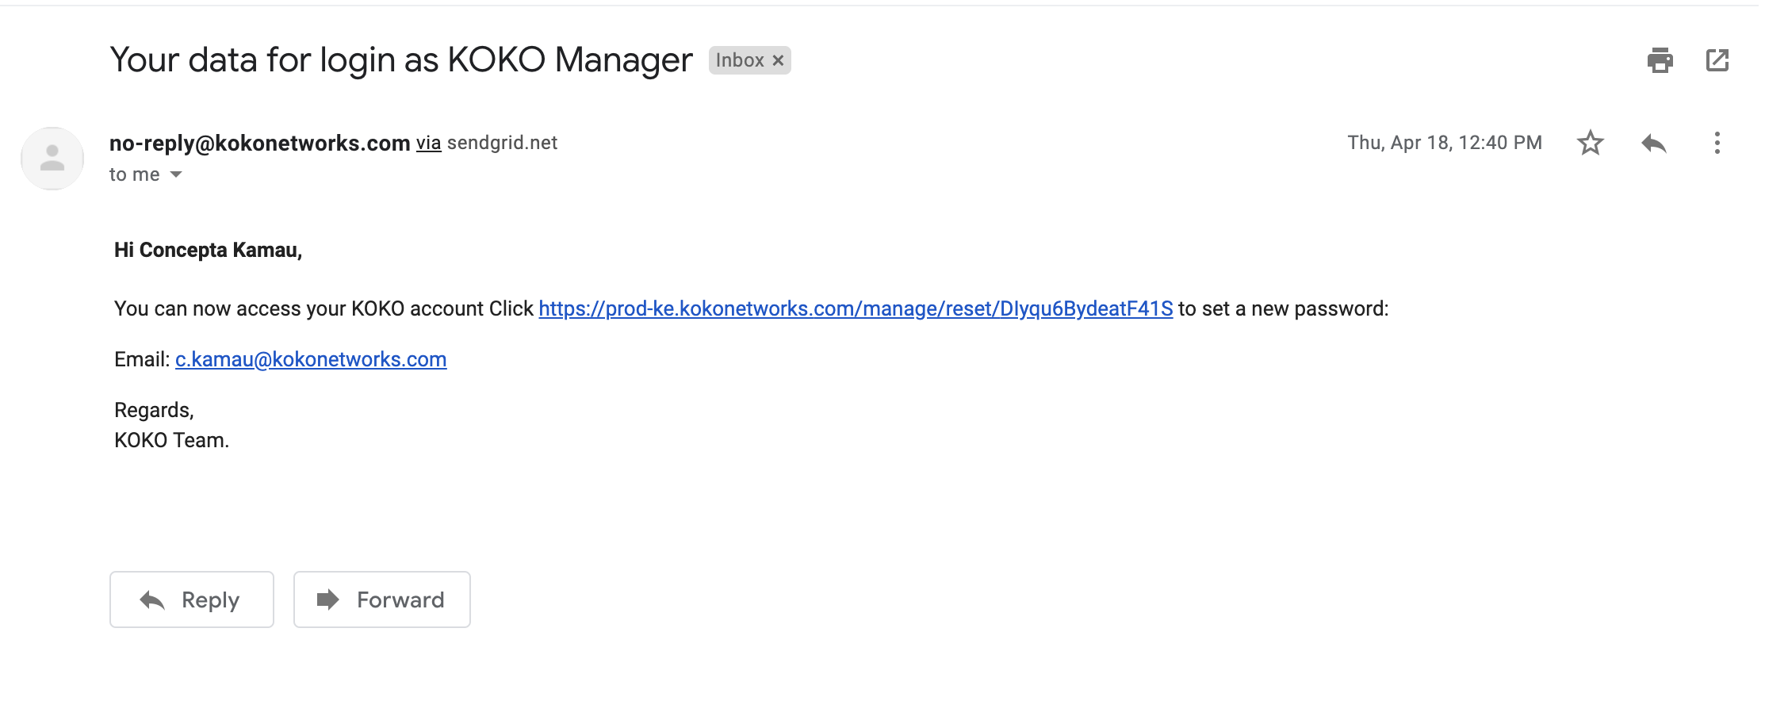
Email invitation
To access KOKO Core, an account has to be created for you.
For this request, email support@kokonetworks.com
Once an account has been created, you will receive an email with a link to set a new password.

Slide 5
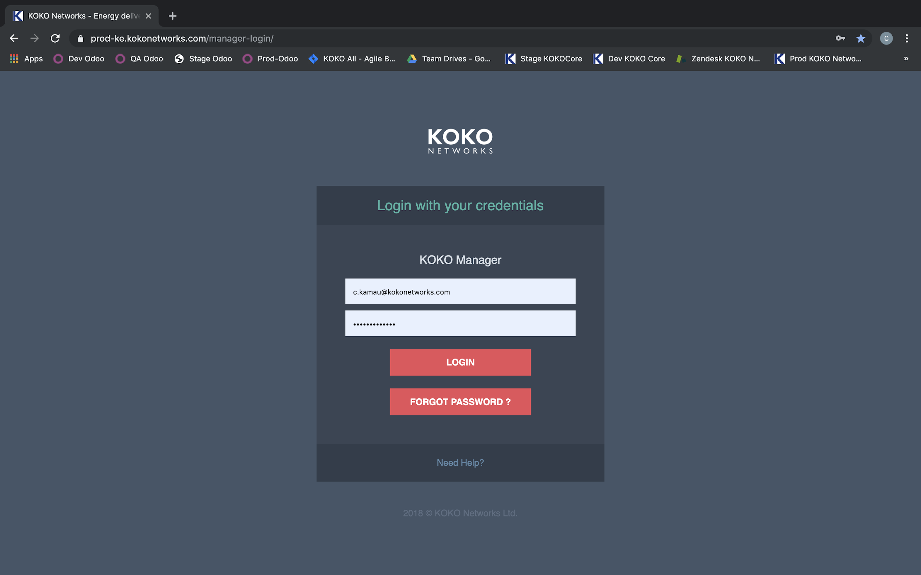
Login
To log in to KOKO Core, you require:
URL: https://prod-ke.kokonetworks.com/manager-login/
Username: c.kamau@kokonetworks.com (valid kokonetworks email address)
Password: once an account is created for you, you will be required to set a password with the following minimum requirements:
Must have upper and lower case character
Must have a numeric character
Must be between 8-20 characters.

Slide 6
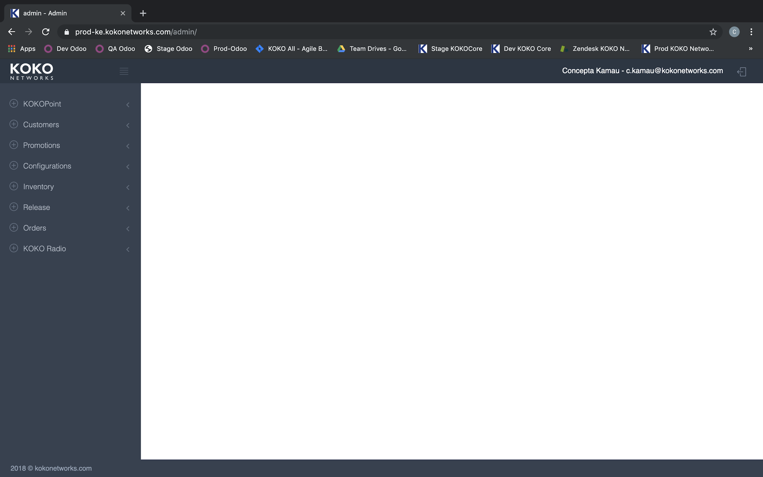
Dashboard/ Menu items
Post-log in, KOKO core gives access to the main menu on the left hand side:
KOKOpoints- this gives access to all KOKOpoints infrastructure that has been deployed in the field
Customers- gives access to customers accounts, top up, purchase details, uploading of new customers and corresponding payments.
Orders- this is the central repository for all customer purchases and sales orders for KOKO cookers, canisters and any other products.

Slide 7
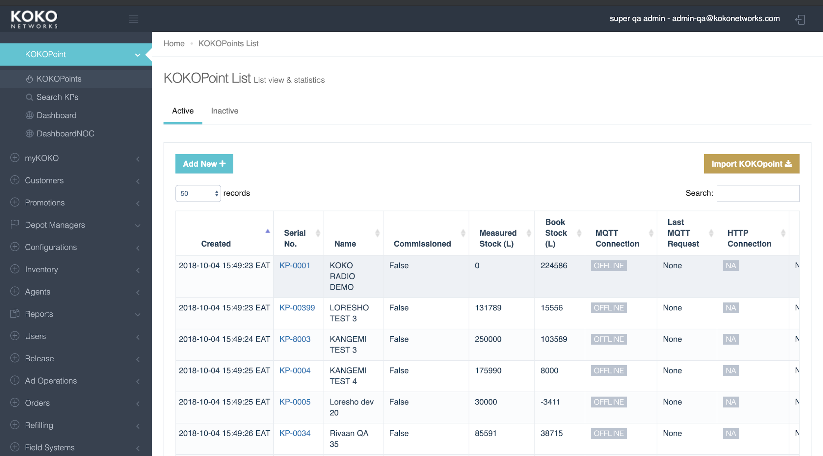
KOKO Points
This is where we have views on KOKO points view and statistics showing status, fuel levels faults, last restart etc; NOC Dashboard.
For use mainly by NOC.
A KP being offline and “out of service” or “offline” indicates that the KOKOPOINT is not functional completely on the ground thus need for follow up. All online KPs with “in service” health status indicates the KP is working well.

Slide 8
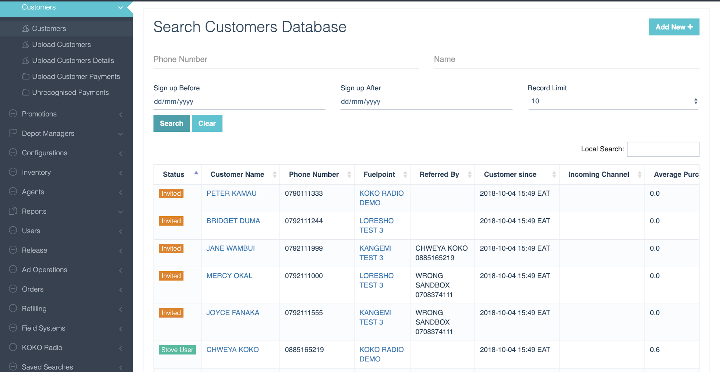
Customers
Gives access to all KOKO Cooker customers
Also used to add new customers details and payments
Customers
The tab for customers helps the Customer Experience team members to check the customer’s account details and advise the customers based on their account details such as PIN reset, account balance, messages sent to customers, customer’s referral code, customer’s name, customer’s phone number and the sign-up location.
Notes:
Customer Status:
Invited- has been invited using a referral code by another existing customer. Have to go through the Set PIN process.
Stove user- Has already purchased a cooker and has collected / fulfilled
Active- has an existing order/ pre-order for a cooker
Disabled- has been disabled from the system and cannot access their account
Reset PIN- Had started the reset PIN/ I don’t know my PIN/ Forgot PIN (depends on the platform used) but has not completed the process of resetting their PIN.
Dashboard information:
Status- as discussed above
Fuelpoint- where the customer last fueled/ signed up
Referred by (where the customer was referred/ used a referral code at sign up
Incoming channel- media used to sign up
Customer since- date of first registration
Search by: Phone number (7XXXXXXXX), Name, Sign up before/ after (for a group of data), Record Limit- 10, 20, 50, 100, 200 etc

Slide 9
Customers
Customer Status:
Invited- has been invited using a referral code by another existing customer. Have to go through the Set PIN process.
Stove user- Has already purchased a cooker and has collected / fulfilled
Active- has an existing order/ pre-order for a cooker
Disabled- has been disabled from the system and cannot access their account
Reset PIN- Had started the reset PIN/ I don’t know my PIN/ Forgot PIN (depends on the platform used) but has not completed the process of resetting their PIN.
Notes:
Customer Status:
Invited- has been invited using a referral code by another existing customer. Have to go through the Set PIN process.
Stove user- Has already purchased a cooker and has collected / fulfilled
Active- has an existing order/ pre-order for a cooker
Disabled- has been disabled from the system and cannot access their account
Reset PIN- Had started the reset PIN/ I don’t know my PIN/ Forgot PIN (depends on the platform used) but has not completed the process of resetting their PIN.
Dashboard information:
Status- as discussed above
Fuelpoint- where the customer last fueled/ signed up
Referred by (where the customer was referred/ used a referral code at sign up
Incoming channel- media used to sign up
Customer since- date of first registration
Search by: Phone number (7XXXXXXXX), Name, Sign up before/ after (for a group of data), Record Limit- 10, 20, 50, 100, 200 etc

Slide 10
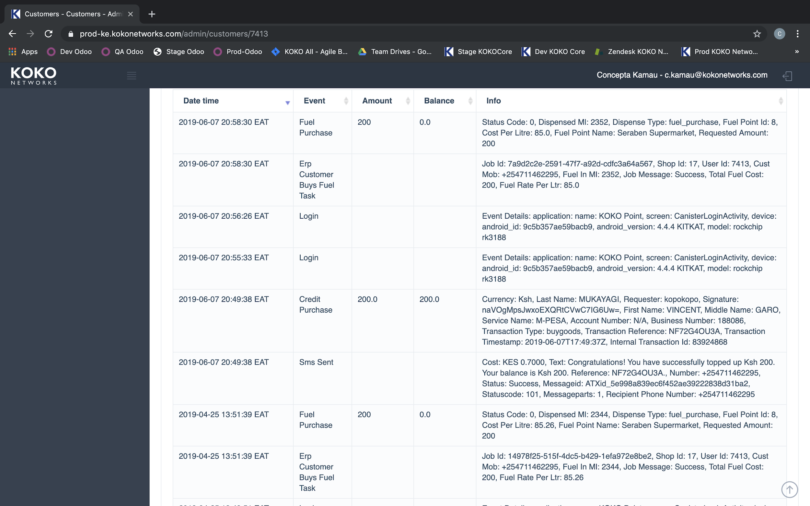
Customer Information- overview
Clicking on the Customer name opens the customer account page that has 3 tabs: Overview, Details and Actions
Events by or against the customer are logged here- Login, Top up through MPESA(credit purchase) SMS sent/received, fuel purchase etc
Events initiated by a KOKO staff through KOKO Admin- Admin Transfer, User PIN reset by Admin etc
Notes:
Login- This is when a customer logs in. Application name: KOKO Point or myKOKO
Credit Purchase- this is a record for a customer top up through MPESA till number.
SMS Sent- is a record of an SMS from KOKO to the customer
Where an event is initiated by a KOKO staff through KOKO manager, the event will contain the terms “Admin Transfer”, “User PIN Reset by Admin” etc. A comment must be put in the case where a staff performs such an action

Slide 11
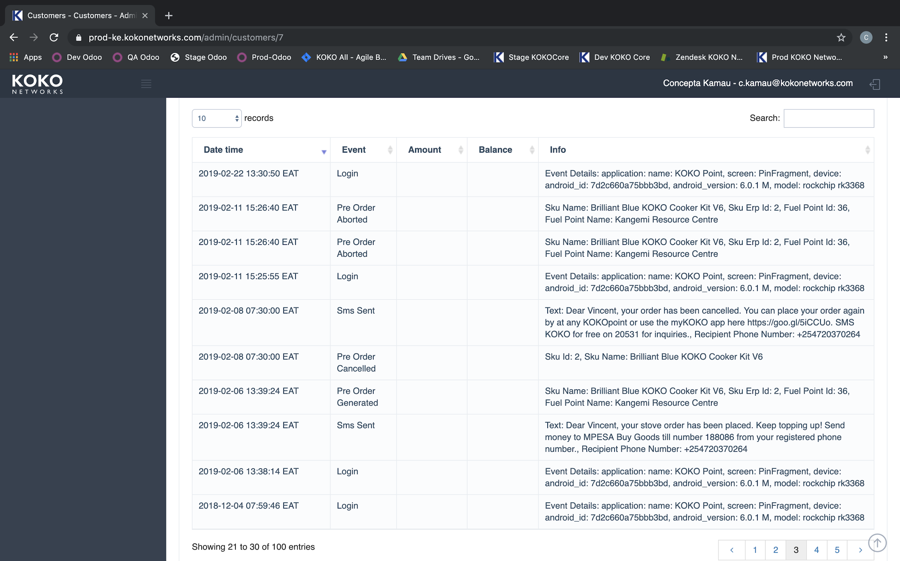
Customer information- overview
Terminologies:
Pre-order cancelled- records cancellation of a pre-order when :
Customer initiates a cooker purchase through start saving option, but does not deposit money to the till number within 14 days. Customers receive a reminder message every 48 hrs.
Request through Customer Support. A cancellation fee (Ksh. 100)is charged and the balance deposited back to customers MPESA.
Pre-order generated- this is the creation of a pre-order (through start saving process).
Note: Pre-order aborted- An aborted pre-order state occured when a customer initiated a cancellation through myKOKO or on a KOKOpoint.A legacy feature.
Notes:
Pre-order aborted- this is when a customer initiates a cooker purchase through the Start saving option and exits the process mid-way- just before the Lipa na MPESA screen option
Pre-order cancelled- this is a record of a cancellation of a pre-order if the customer initiates a cooker purchase through start saving option, but does not start depositing money to the till number within 14 days. Usually the customer will receive a reminder message every 48hrs.

Slide 12
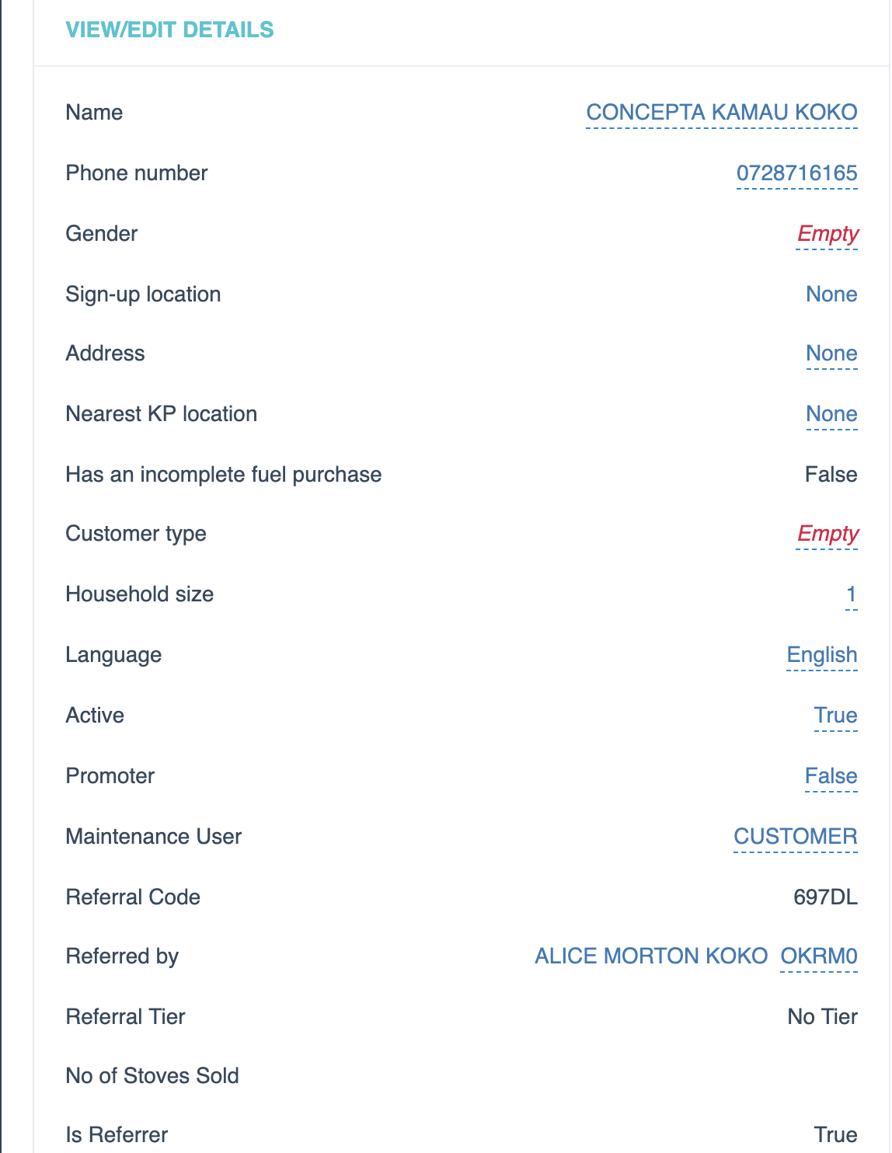
Customer information- details
Name- names as registered during sign-up
Phone Number- primary phone number registered during sign up. This is the account identifier.
Promoter- this is true for a KOKO staff who is a promoter.
Referral code- this is assigned by default when a customer account is created
Referred by- where a customer was referred, the referral code/ referrer is recorded.
Sign up status
active
disabled
reset PIN
stove user
Notes:
The screens show the customer details.
NB: Primary account Balance shows the current KOKO Credit/ Money in the customer wallet
Inventory shows the number of canisters assigned to the customer during collect cooker / canister process.

Slide 13
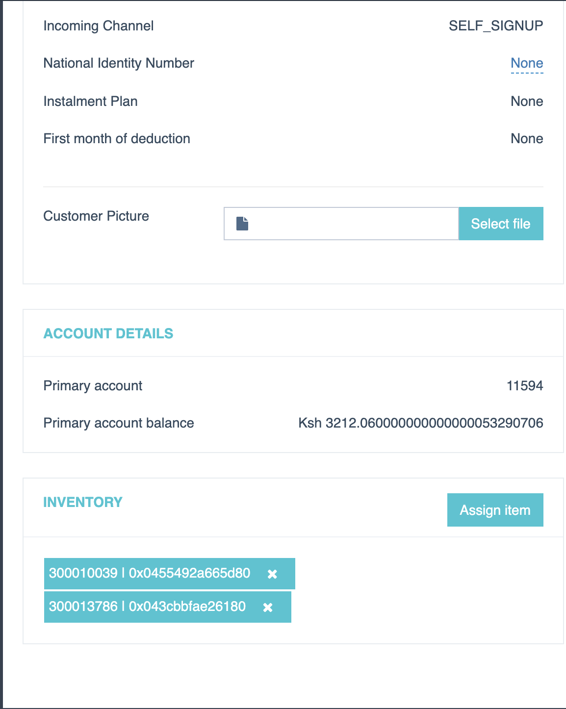
Customer information- details
Incoming channel:
Self- done through myKOKO or KOKOpoint
Promoter- sign up is through referral
B2B- for B2B customers e.g. saccos
Admin sign up- account created through KOKO manager
Primary account Balance- current money/KOKO credit is in the customer wallet.
Inventory- where a customer is a stove user, a canister Serial ID and NFC tag will be seen here
Notes:
The screens show the customer details.
NB: Primary account Balance shows the current KOKO Credit/ Money in the customer wallet
Inventory shows the number of canisters assigned to the customer during collect cooker / canister process.

Slide 14
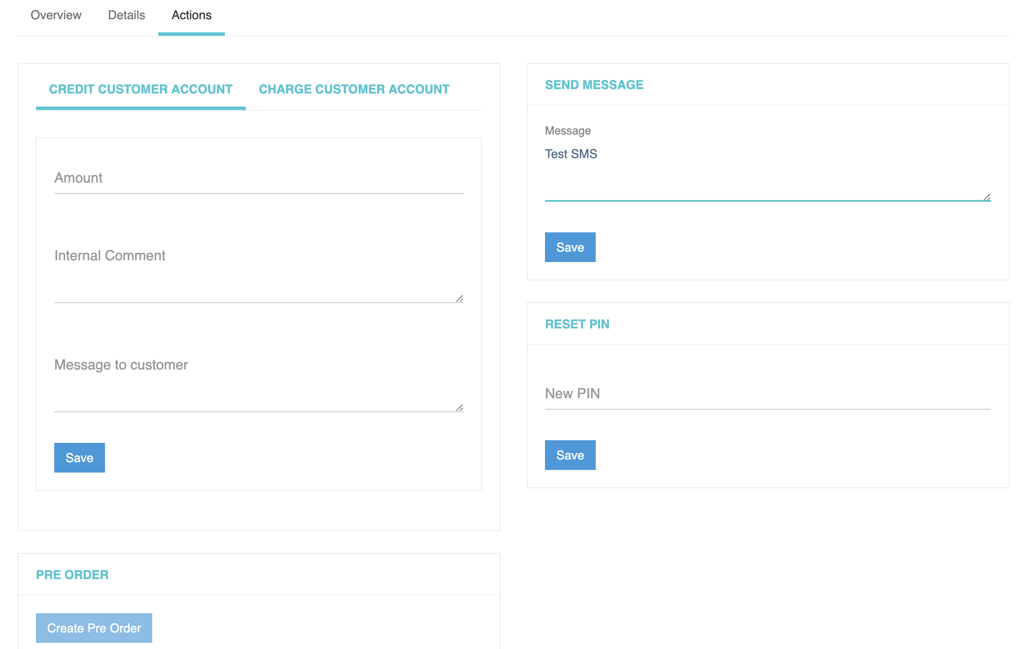
Customer information- actions
Actions that can be done here are:
Crediting a customer account- this is the action of putting additional KOKO credit to the customer wallet.
Charging a customer account- is the action of deducting KOKO credit from a customer’s account.
Send message to a customer
Reset PIN- Set a new PIN on behalf of the customer
Create a pre-order on behalf of a customer
NB: Crediting and charging a customer’s account must be accompanied by a reason.

Slide 15
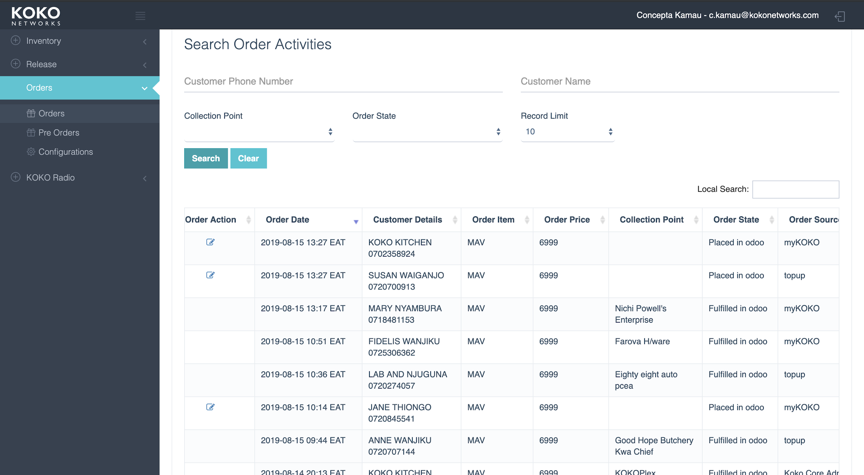
Orders
In this menu, the customers’ cooker orders are found: Search options. View order list view- date, customer.
Ordered item and price
Collection point- agent location where the order was collected/ fulfilled.
Order state
placed in Odoo- order fully paid for and there is a draft Sales Order in the ERP to facilitate fulfillment and accounting
fulfilled in Odoo- an order that has been collected by customer, and inventory has been consumed
Order source- where order came in through
Notes:
Search by Phone number - 7XXXXXXX
Record Limit- 10, 20, 50, 100 etc
Order state:
Placed in Odoo- this means that there is a Draft Sales Order in the ERP
Fulfilled in Odoo- This means that the customer collecte their cooker, fulfilled by entering the kit serial ID on the KP, the Kit was consumed in our inventory and the canister tag assigned to the customer. (This is visible in Inventory under Customer Details)
Cancelled- The order was cancelled at the request of the customer and funds were returned back to the customer’s MPESA.

Slide 16
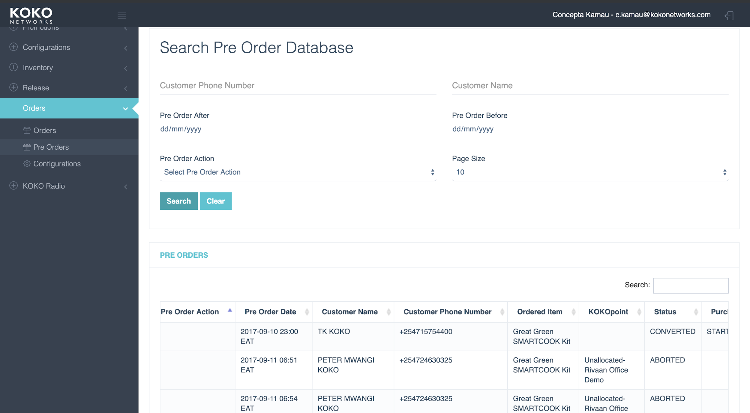
Savings Orders
Pre-order view:
Allows one to:
Search by the below parameters:
Name
Phone number
Pre-order dates (after or before) Pre-order action (buy now or start saving)
Page size- number of records
View a list of pre-orders and corresponding parameters:
Pre-order action- allows editing based on access rights.
Pre-order date
Customer Name and phone number
Order item
KOKOpoint- if the pre-order was generated on a KOKOpoint
Notes:
Pre-order view:
Search options by Name, Phone number, pre-order after/ before, Pre-order action (buy now or start saving), and page size- number of records

Slide 17
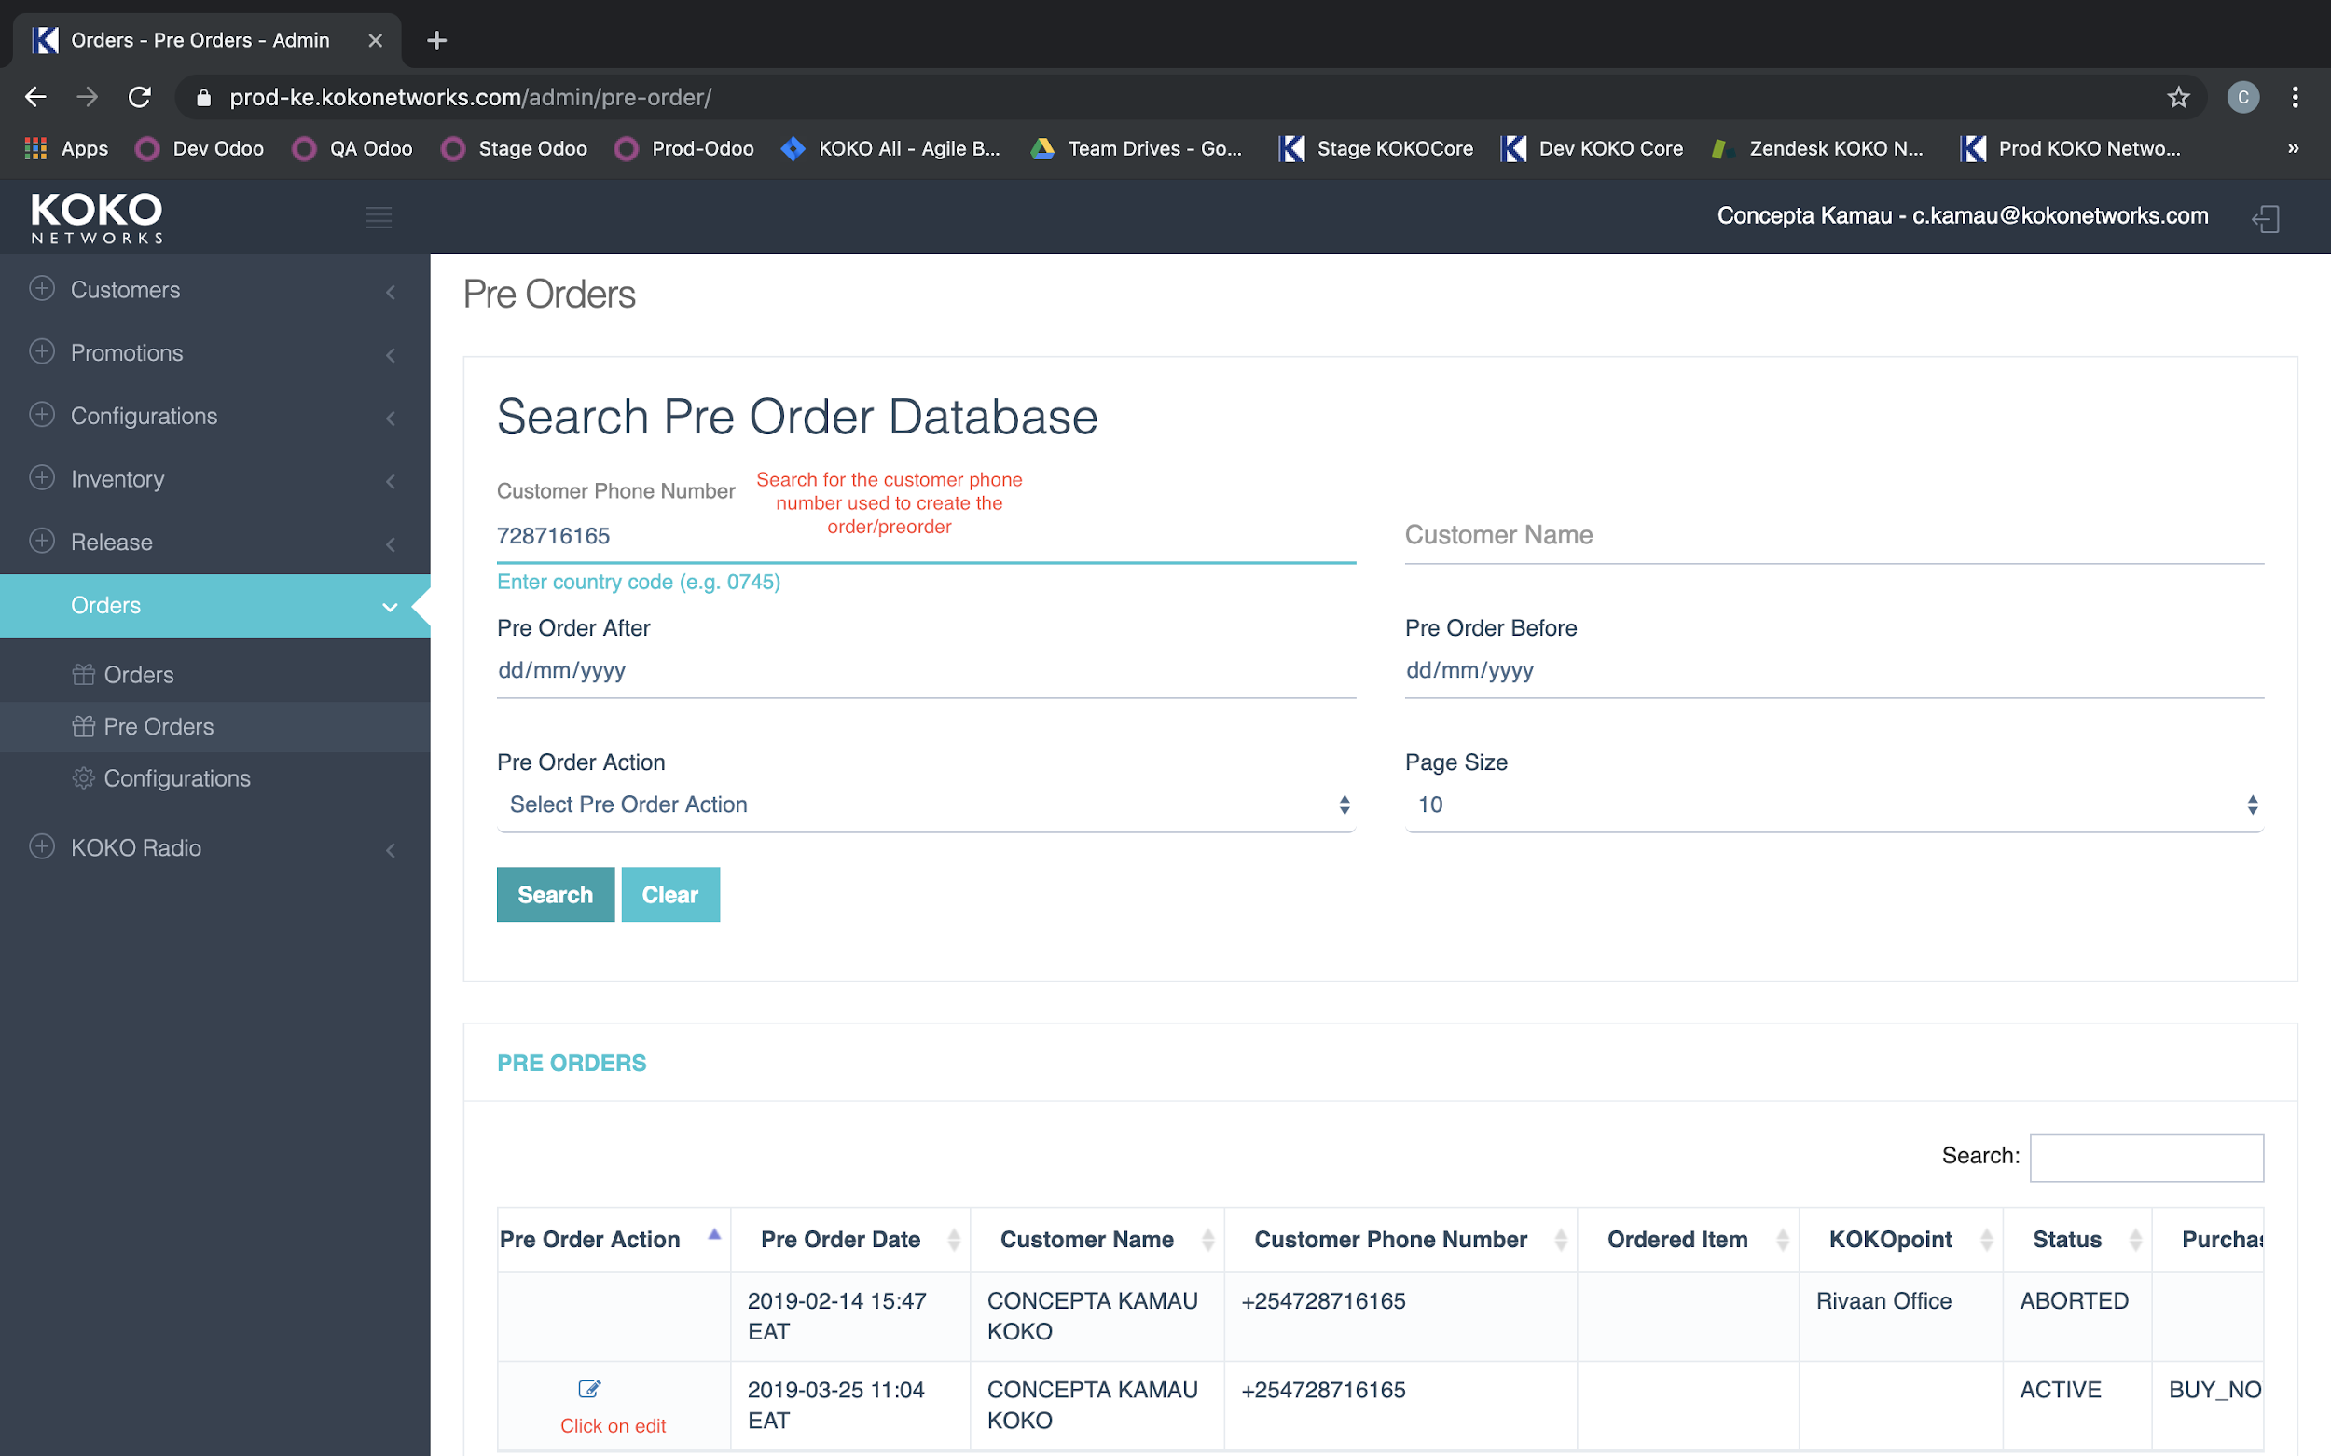
Cancelling orders/ pre-orders (also here)
orders/preorders menu
search customer order/pre-order using phone number
Click on edit Icon
Click on Cancel
Enter cancellation reason on pop-up and click ok
Notes:
Edit icon, click on Cancel. Must be accompanied by a reason.
Same process for orders

Slide 18
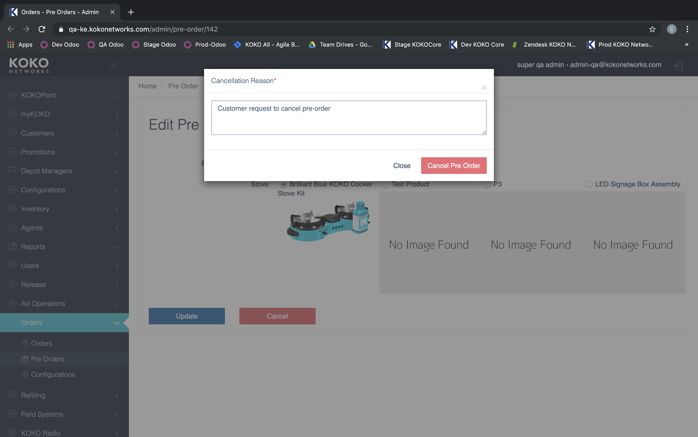
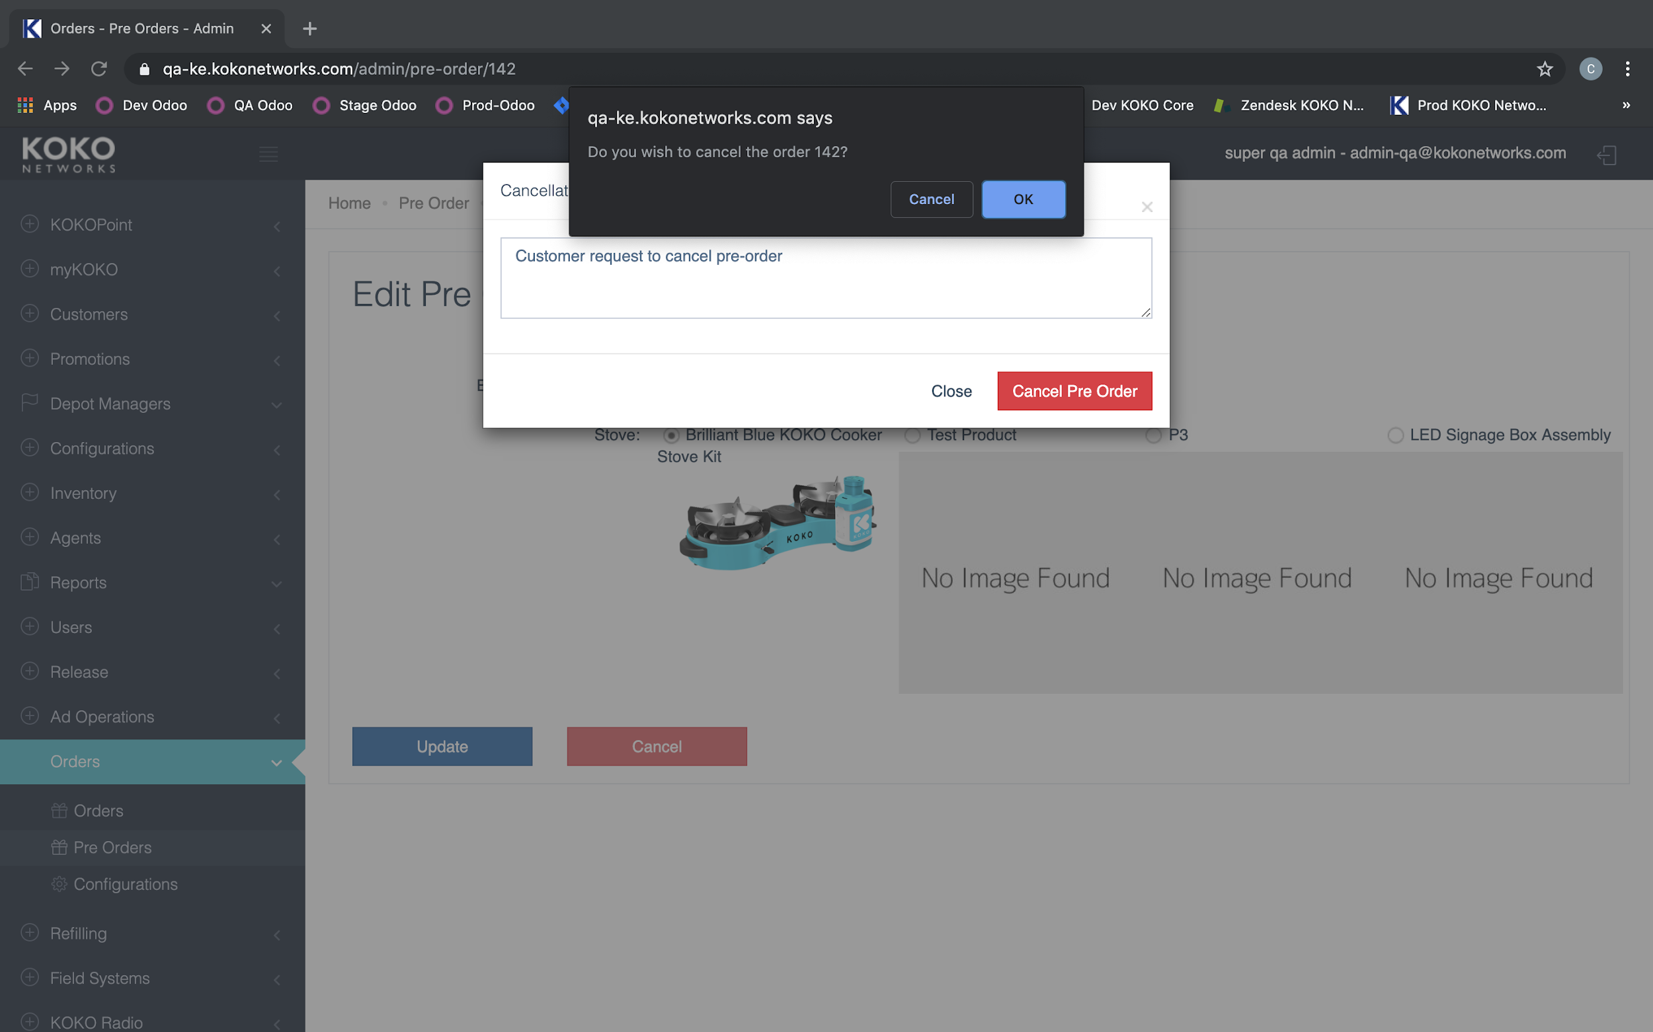
Cancelling orders/ pre-orders
orders/preorders menu
search customer order/pre-order using phone number
Click on edit Icon
Click on Cancel
Enter cancellation reason on pop-up and click ok
Notes:
Edit icon, click on Cancel. Must be accompanied by a reason.
Same process for orders

Slide 19
Customer Account Merge / Transfer / Deregistration
Account::Termination::Account deregistration
Merge customer acounts / transfer Account::Termination::Account transfer
Account A: Customer wants to use this account
Account B: Customer no longer want to use this account
Process:
charge account B with the current balance
credit account A with the same balance amount as charged from account B
make account B’s ‘Active’ field as = False

Slide 20
Account::Login::PIN recovery
xxx

Slide 21
Account::Credit / Debit
If crediting a stove
create a pre-order and then credit the customer ksh 6999. if already have a pre-order no need to create (grayed out)
If just crediting / debiting
Also includes transfering of $$$ b/c that is just a credit + a debit
OR also for Account::Credit::KOKO credit transfer
e.g., different phone number used to pay
Most important is the internal comment on why you are performing the credit or debit

Slide 22
Account::Credit::Refund request
Account::Credit::transaction not reflecting on KOKO account

Slide 23
KIT Transfers: Inquiry::Existing customer::Transfer of kit ownership
Kit Transfer
3 different scenarios
1. Pre order placement
2. Pre order fulfilment
3. post order fulfillment
1, 2: If a customer has not fulfilled, we could change the name / number on the account if customer A has no desire to be a customer or buy for themselves
Otherwise (if they are a stove owner already or have a balance), transfer canister to customer B. If not used, credit fuel bonus / transfer fuel bonus
Transfer canister to the respective new number. Credit fuel to new number if no fuel bonus received / transfer fuel bonus if not used
Unassign canister and reAssign canister to the new customer,
Call the customer and notify them to use their new Cooker kit.

Slide 24
Customer A wants to buy Cooker for Customer B
Customer A wants to buy/gift a cooker for Customer B
Customer B creates an account with their phone number. Use customer A’s referral code (OR CS creates account)
Customer B places an order
Customer A tops-up their account with 6999
CS transfers the money from Customer A to Customer B’s account
Notify Customer A that Customer B can now collect their cooker

Slide 25
REset PIN
Account activation. Customers will reach out to KOKO Networks when they block their PIN or they do not remember their PIN number thus need for PIN reset. As the Customer Service Agent, it is their responsibility to ensure the PIN is private for the customer alone. Below are the steps to guide the customer and the steps to take under Customer Experience:
Log into the customer’s account,
Call the customer to confirm their security question answer,
Once the customer has confirmed the correct details,
Go to details, then click on the security question,
Then go to actions and enter 4 easy to remember random digits,
Go to details again and move to active, then select true,
Call the customer and notify them to check their SMS to ensure they received the new temporary PIN.
Once the customer is fully satisfied close the ticket and capture the accurate tags and topics, incase it is a ticket.

Slide 26
Phone Number Reassignment
Customers will reach out to us once they change their phone number and they are unable to access their account.
To change the customer’s phone number,
Enter the customer’s phone number under customers in the admin,
Click on details,
Click the customer’s phone number, you will see an edit icon,
Change the customer’s phone number and click the “tick” icon,
The phone number is changed, call the customer to notify them of the changes.

Slide 27
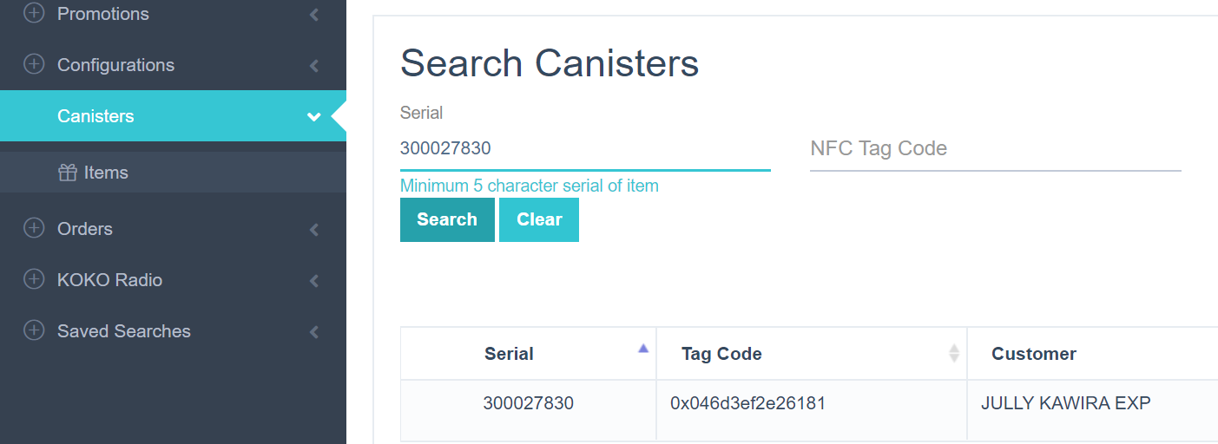
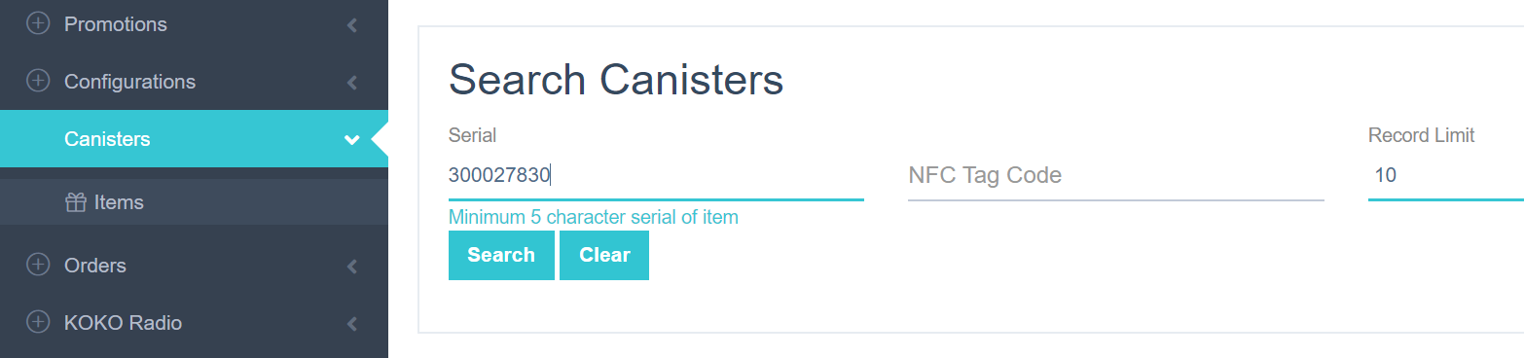
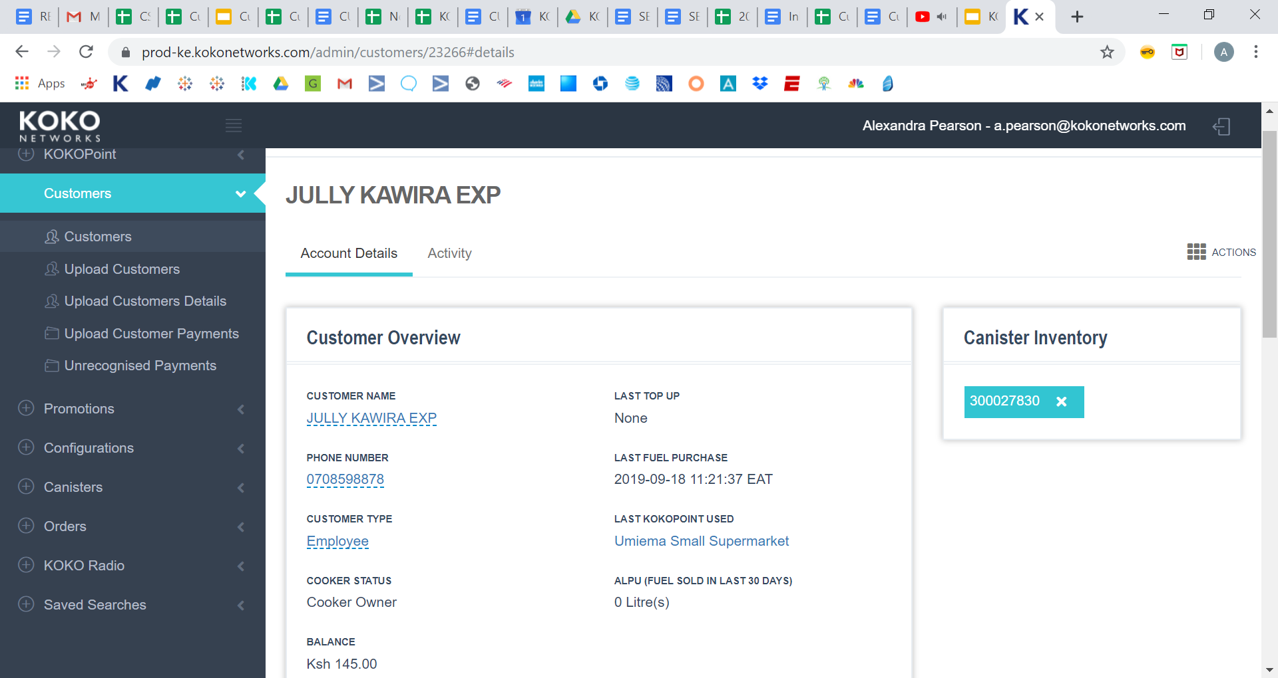
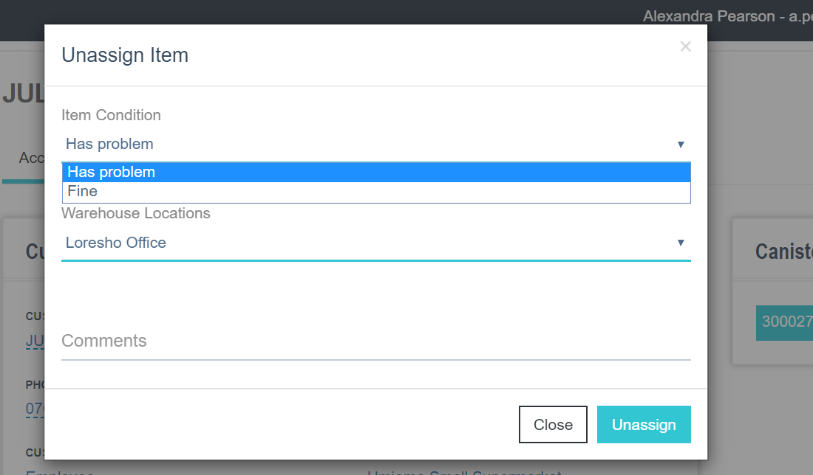
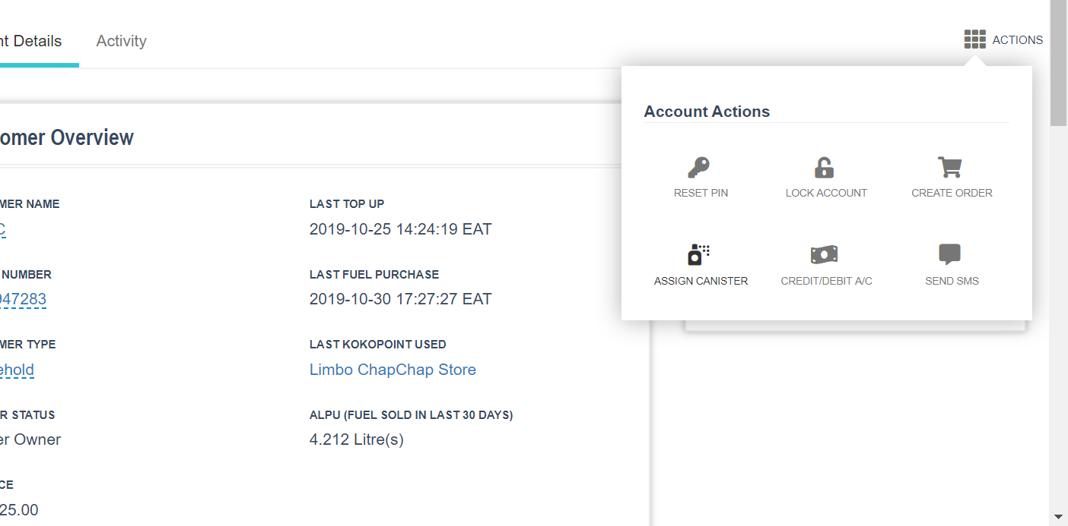
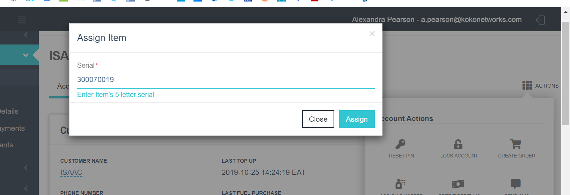
Canister Assignment & Reassignment
Need a canister serial ID | (skip to step 4 if canister has not been assigned to a customer)
1. On KOKOcore click on ‘Canisters” -> ‘Items”. Enter canister serial ID. Click “Search”. Note the name of the customer who currently owns the canister. If there is currently no owner, proceed to step 4
2. Go to “Customers” -> “Customers”. Enter customer name you noted in the previous step. Pull up that customer's account. You should see the same canister ID. 3. Click on the ‘X’ next to the ID. In the first dropdown select why you are removing the canister and add comment. Click “unassign”. Click OK
4. Now go to customer you want to assign the canister to (click “Customers” on the left). Once on the customer’s account page, click “assign canister” from the actions menu. Paste the canister ID and click “assign”. Click OK. Customer now has canister assigned to their account.

Slide 28

Q&A

